Slide 1
QMS Dashboard

Slide 2
Background
The QMS Dashboard is used to View or Track the QMS/PCB/EHS Reports of Suppliers.
Dashboard is used to monitor the status of QMS Certificates uploaded by vendors .
Can be able to View the certificates
Scope of the Project :
Currently the QMS dashboard has deviations
Checks and control can be added to make the dashboard User friendly

Slide 3
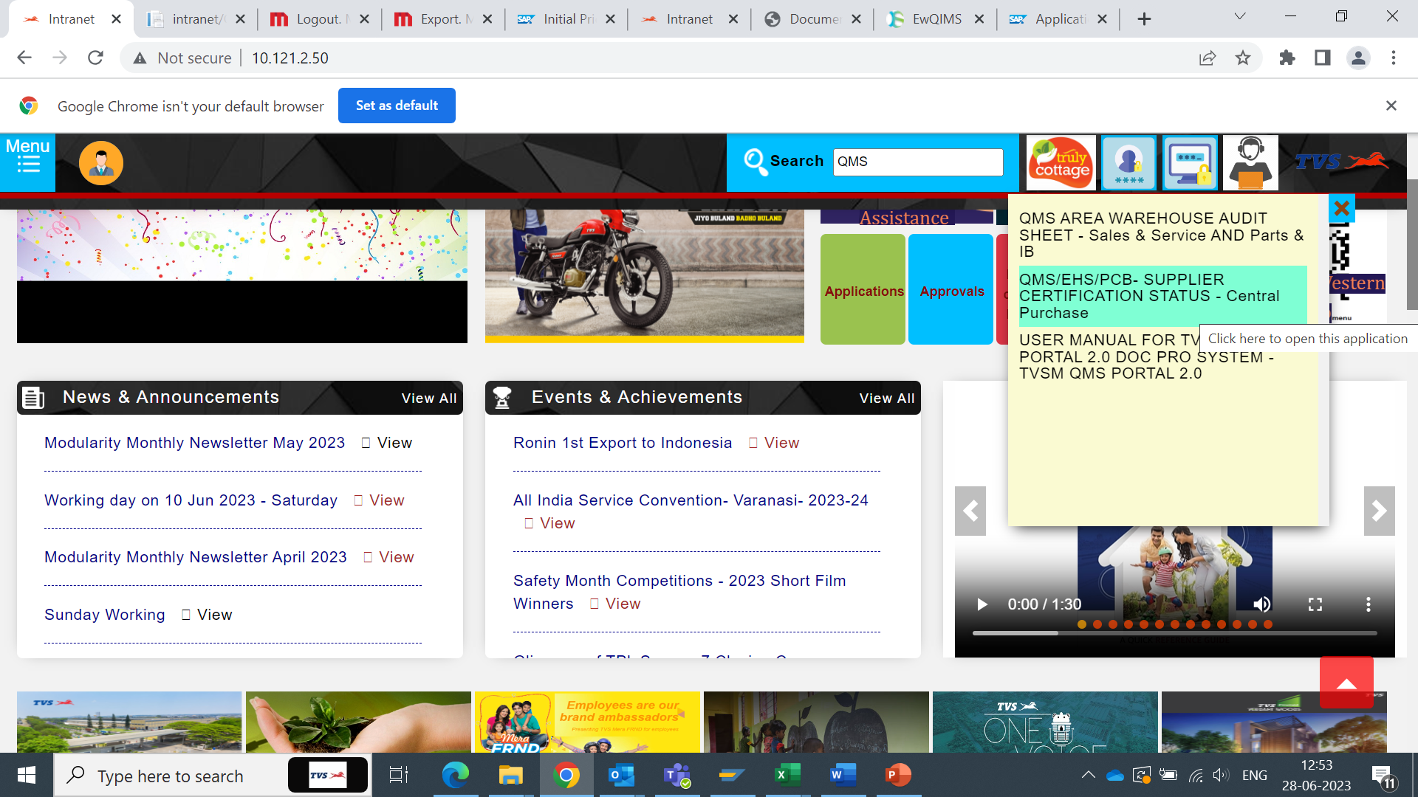
Step:1
Intranet – Type QMS on the Search button – Click on QMS /EHS/PCB Certification

Slide 4
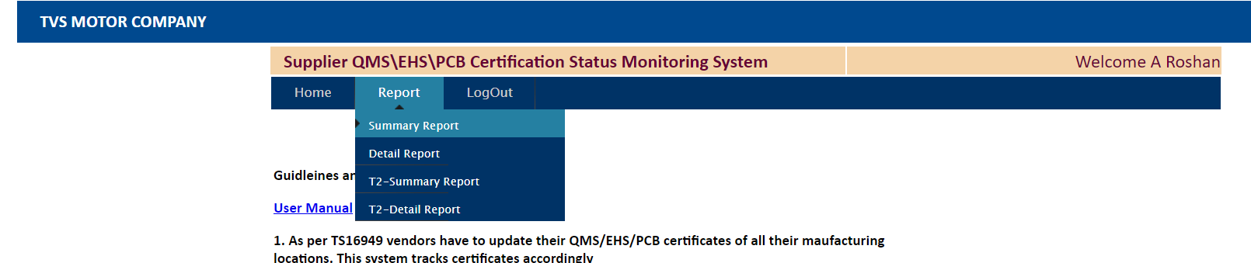
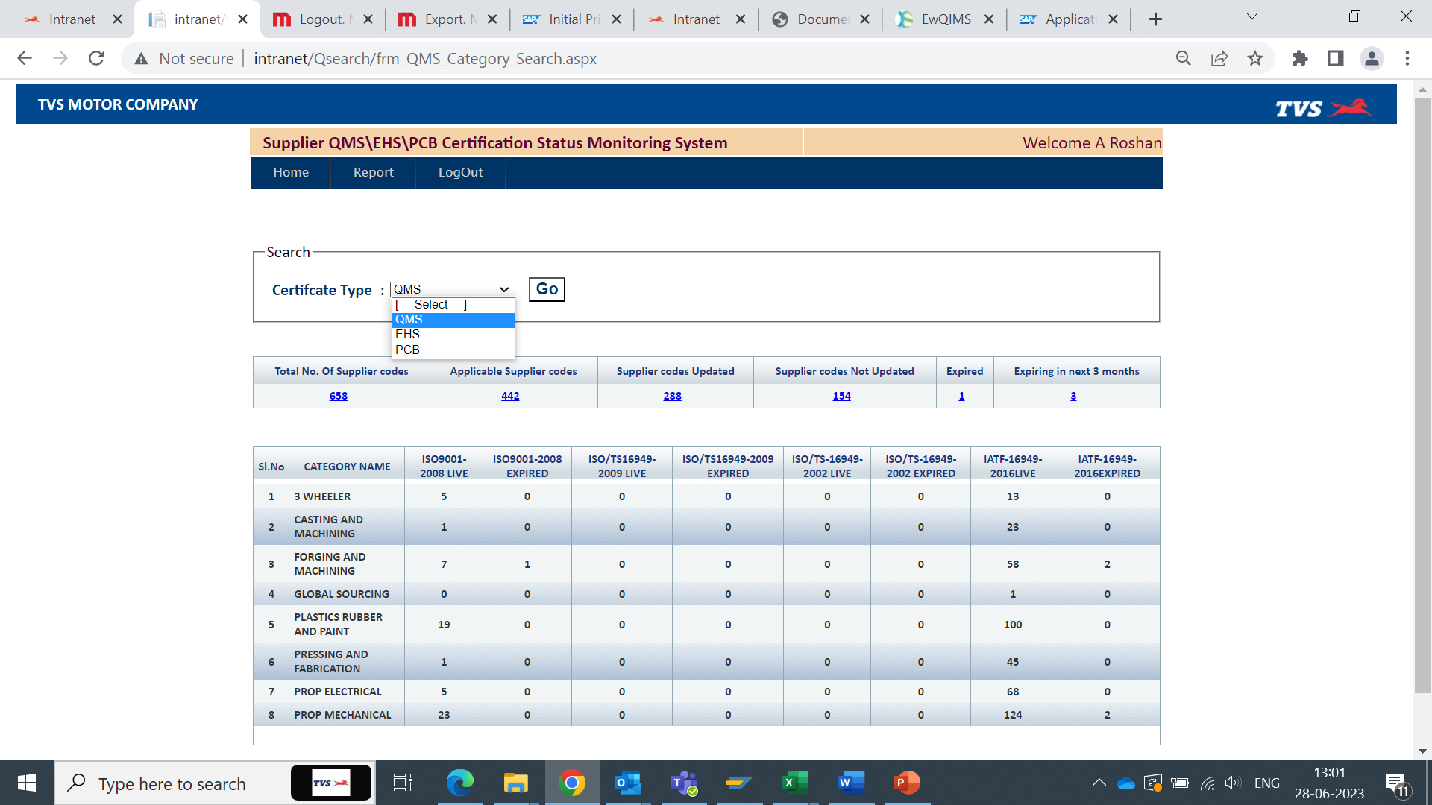
Step:2
Report : Click on the Detail Report
Certificate type : QMS

Slide 5
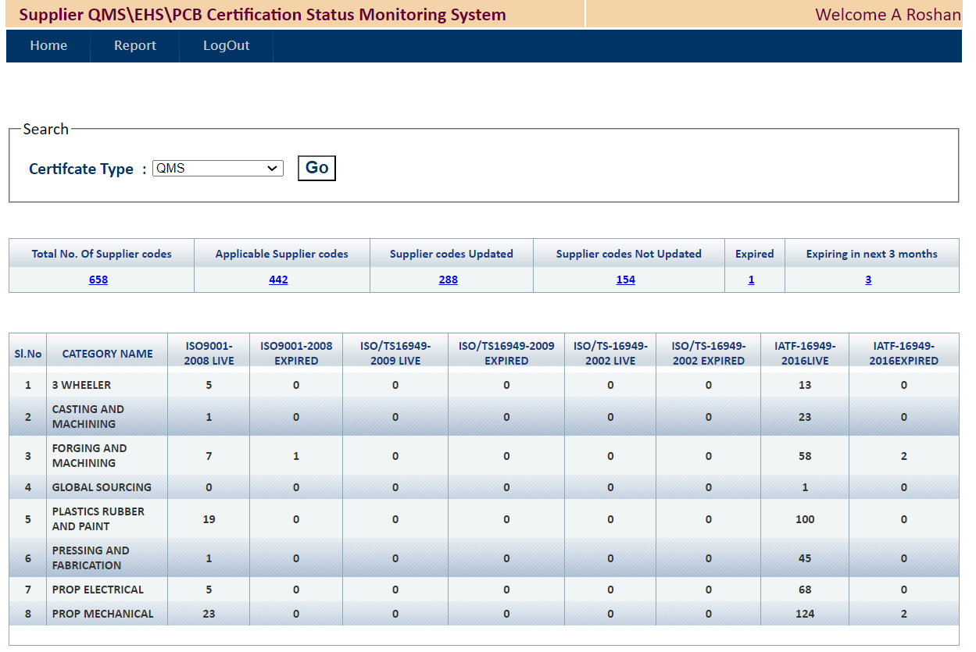
Step:3
Intranet – Type QMS on the Search button – Click on QMS /EHS/PCB Certification
Intranet – Type QMS on the Search button – Click on QMS /EHS/PCB Certification

Slide 6
Improvement Points :
1) Total Number of suppliers code : Remove the Non-Active suppliers form the list
2) Total Applicable vendors : Add one more column to differentiate Plant & Warehouse
3) Expired : Many Suppliers are not captured .
4) Summary Can be defined (Refer Page 7) .
5) Expiring in 3 Months : Mail Trigger to be send to Internal & Suppliers.
6) Category : EV also to be Added . 7) Export Option to provide for downloading the summary
8) This is applicable for EHS & PCB Certificates .
9) Summary data : Daily Auto mail Trigger to CP Category heads & Sections heads can be sent .
10) Tier 1 & 2 Tab can be removed .
11) ISO14001 and ISO9001-2008 Can be removed

Slide 7
Summary Table output after downloading
VENDOR CODE | VENDOR NAME | CATEGORY | IATF-16949-2016 | ISO14001 | ISO9001-2008 | OHSAS18001 | PCB-AIR | PCB-HAZ-MATL | PCB-WATER
20017 | BALAJI PRESS PRODUCTS INDIA | PRESSING AND FABRICATION | 2024-05-25 | Not Available | Not Available | Not Available | Not Available | Not Available | Not Available
20018 | BANCO PRODUCTS (INDIA) LIMITED | PROP MECHANICAL | 2024-09-25 | Not Available | Not Available | Not Available | Not Available | Not Available | Not Available
20019 | BERGER PAINTS INDIA LIMITED | PLASTICS RUBBER AND PAINT | Not Available | 2024-01-26 | 2024-09-28 | Not Available | 2025-07-31 | 2025-07-31 | 2025-07-31
20021 | 3M INDIA LIMITED | PLASTICS RUBBER AND PAINT | 2024-09-15 | 2024-01-26 | Not Available | 2024-01-26 | Not Available | Not Available | Not Available
20023 | CANARA STANDARD KEYS | FORGING AND MACHINING | Not Available | Not Available | Not Available | Not Available | Not Available | Not Available | 2062-11-18
20024 | CHAMPION PLASTICS (INDIA) | PLASTICS RUBBER AND PAINT | 2025-01-25 | Not Available | Not Available | Not Available | 2024-03-31 | Not Available | 2024-03-31
20025 | CHAND PRESS PRODUCTS | PRESSING AND FABRICATION | 2025-04-09 | Not Available | Not Available | Not Available | 2027-12-31 | Not Available | Not Available
20026 | CHHEDA ELECTRICALS & ELECTRONICS | PROP ELECTRICAL | 2025-04-06 | Not Available | Not Available | Not Available | 2025-03-31 | 2025-03-31 | 2025-03-31
20030 | DIMO CASTINGS PRIVATE LIMITED | CASTING AND MACHINING | 2024-12-06 | Not Available | Not Available | Not Available | 2031-09-30 | Not Available | Not Available
20034 | ELKAYEM AUTO ANCILLARIES PRIVATE | PRESSING AND FABRICATION | 2024-05-11 | Not Available | Not Available | Not Available | Not Available | Not Available | Not Available
20035 | ELKAYEM AUTO ANCILLARIES PRIVATE | PRESSING AND FABRICATION | 2024-05-16 | Not Available | Not Available | Not Available | 2024-12-31 | 2024-12-31 | 2024-12-31
20036 | EMERGENCY KITS INDIA PRIVATE | PROP MECHANICAL | Not Available | Not Available | 2025-03-13 | Not Available | Not Available | Not Available | Not Available
20050 | FIEM INDUSTRIES LIMITED | PROP ELECTRICAL | 2024-08-20 | Not Available | Not Available | Not Available | 2023-09-30 | 2023-09-30 | Not Available
20052 | G.I.AUTO PRIVATE LIMITED | FORGING AND MACHINING | 2024-03-05 | Not Available | 2024-03-05 | Not Available | 2033-12-31 | Not Available | 2026-12-31
20055 | GABRIEL INDIA LIMITED | PROP MECHANICAL | 2025-01-10 | Not Available | Not Available | Not Available | Not Available | Not Available | Not Available
20062 | GOWRISHANKAR ENGINEERING | FORGING AND MACHINING | 2025-08-09 | Not Available | Not Available | Not Available | Not Available | Not Available | 2027-06-30
20066 | HI-TECH ARAI PRIVATE LIMITED | PROP MECHANICAL | 2024-06-25 | 2025-03-15 | Not Available | Not Available | Not Available | 2026-03-31 | Not Available
Certificate Uploaded can be indicated as Green with Expiry date.
Not Uploaded Can in Red Font .
Expiry can be in orange Font .

